Slide 1
Login Service Program
SK VIP 1
전자공학과 2021304016 김어진
컴퓨터공학과 2021305022 김호중

Slide 2
Table of Contents
다중 접속 서버
Login Service
- Functional Flow
- Login Service Overview
- Login Service Client
- Login Service Server
- Demo Video

Slide 3
다중 접속 서버

Slide 4
멀티 프로세스 기반 서버
server
parent process
child process
child process
child process
client 1
client 2
client 3

Slide 5
멀티 프로세스 기반 서버
listen_sock
bind( )
listen( )
s (client socket)
connect( )
for( ; ; )
accp_sock
accept( )
fork( )
parent
child
close(accp_sock)
close(listen_sock)
// leap to for loop
// connect with client

Slide 6
Login Service

Slide 7
Functional Flow
server
client
sigaction
socket
socket
bind
listen
connect
accept
login service

Slide 8
Login Service Overview
Login Mode
exit
login_serv
login_client
exit
Send Mode
recv_and_print
input_and_send

Slide 9
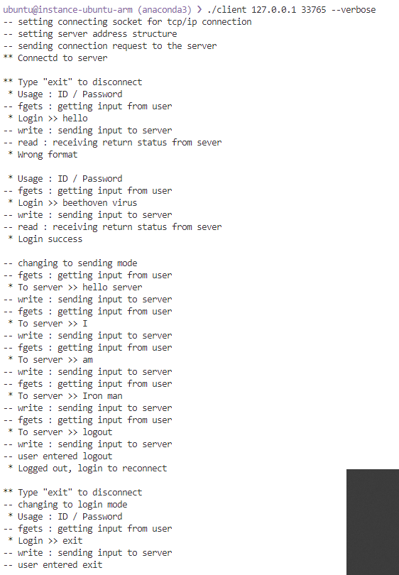

Login Service Client
socket
tcp/ip functional flow
connect
exit
login_client
input_and_send

Slide 10
Login Service Client
socket
잘못된 로그인 형식
connect
exit
login_client
input_and_send

Slide 11
Login Service Client
socket
로그인 성공 후,
server에게 입력값을 보내는 모드로 전환
connect
exit
login_client
input_and_send

Slide 12
Login Service Client
socket
server에게 입력값 전달
connect
exit
login_client
input_and_send

Slide 13
Login Service Client
socket
logout 입력
다시 login 모드로 전환
connect
exit
login_client
input_and_send

Slide 14
Login Service Client
socket
connect
exit 입력
login service 종료
exit
login_client
input_and_send

Slide 15
Login Service Client
socket
connect
server와 연결 해제 후
프로그램 종료
exit
login_client
input_and_send

Slide 16
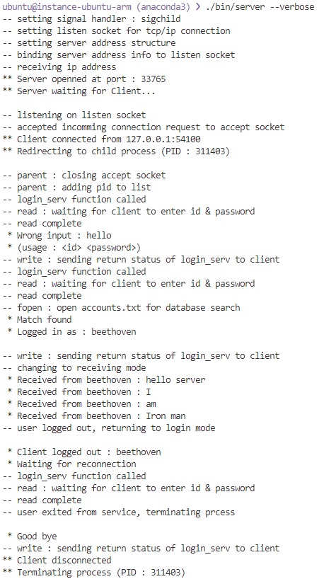
Login Service Server
sigaction
tcp/ip functional flow
socket
bind
listen
accept
exit
login_serv
recv_and_print

Slide 17
Login Service Server
sigaction
socket
bind
잘못된 로그인 형식
listen
accept
exit
login_serv
recv_and_print

Slide 18
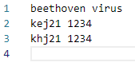
Login Service Server
sigaction
<account.txt>
socket
bind
account.txt 파일의 정보와 입력값 비교
일치하면 로그인 성공
listen
accept
exit
login_serv
recv_and_print

Slide 19
Login Service Server
sigaction
socket
bind
client로부터 입력을 받아들이는 모드로 전환
listen
accept
exit
login_serv
recv_and_print

Slide 20
Login Service Server
sigaction
socket
bind
listen
client로부터 logout 입력받음
다시 login 모드로 전환
accept
exit
login_serv
recv_and_print

Slide 21
Login Service Server
sigaction
socket
bind
listen
client로부터 exit 입력받음
login service 종료
accept
exit
login_serv
recv_and_print

Slide 22
Login Service Server
sigaction
socket
bind
listen
accept
client와 연결 해제 후
child process 종료
exit
login_serv
recv_and_print

Slide 23
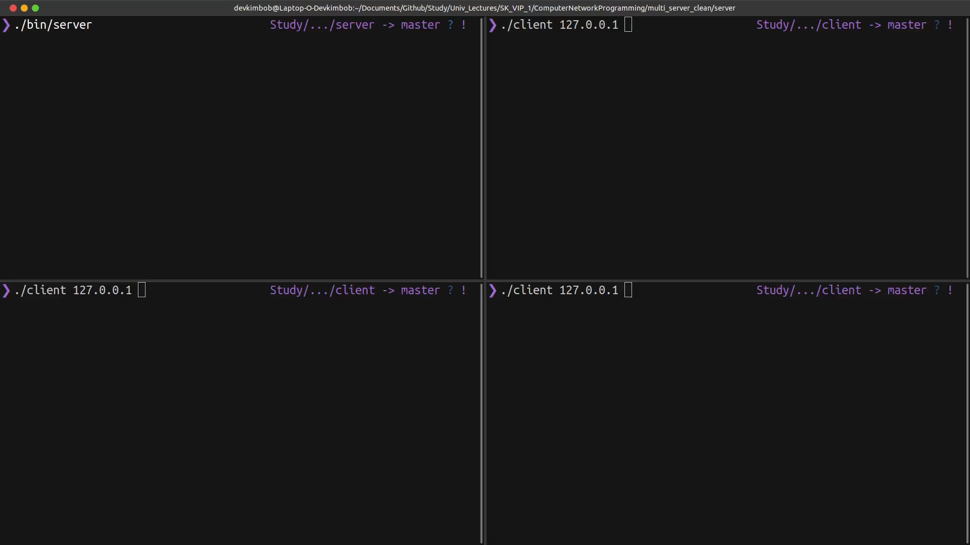
실행 영상 – clean run

Slide 24
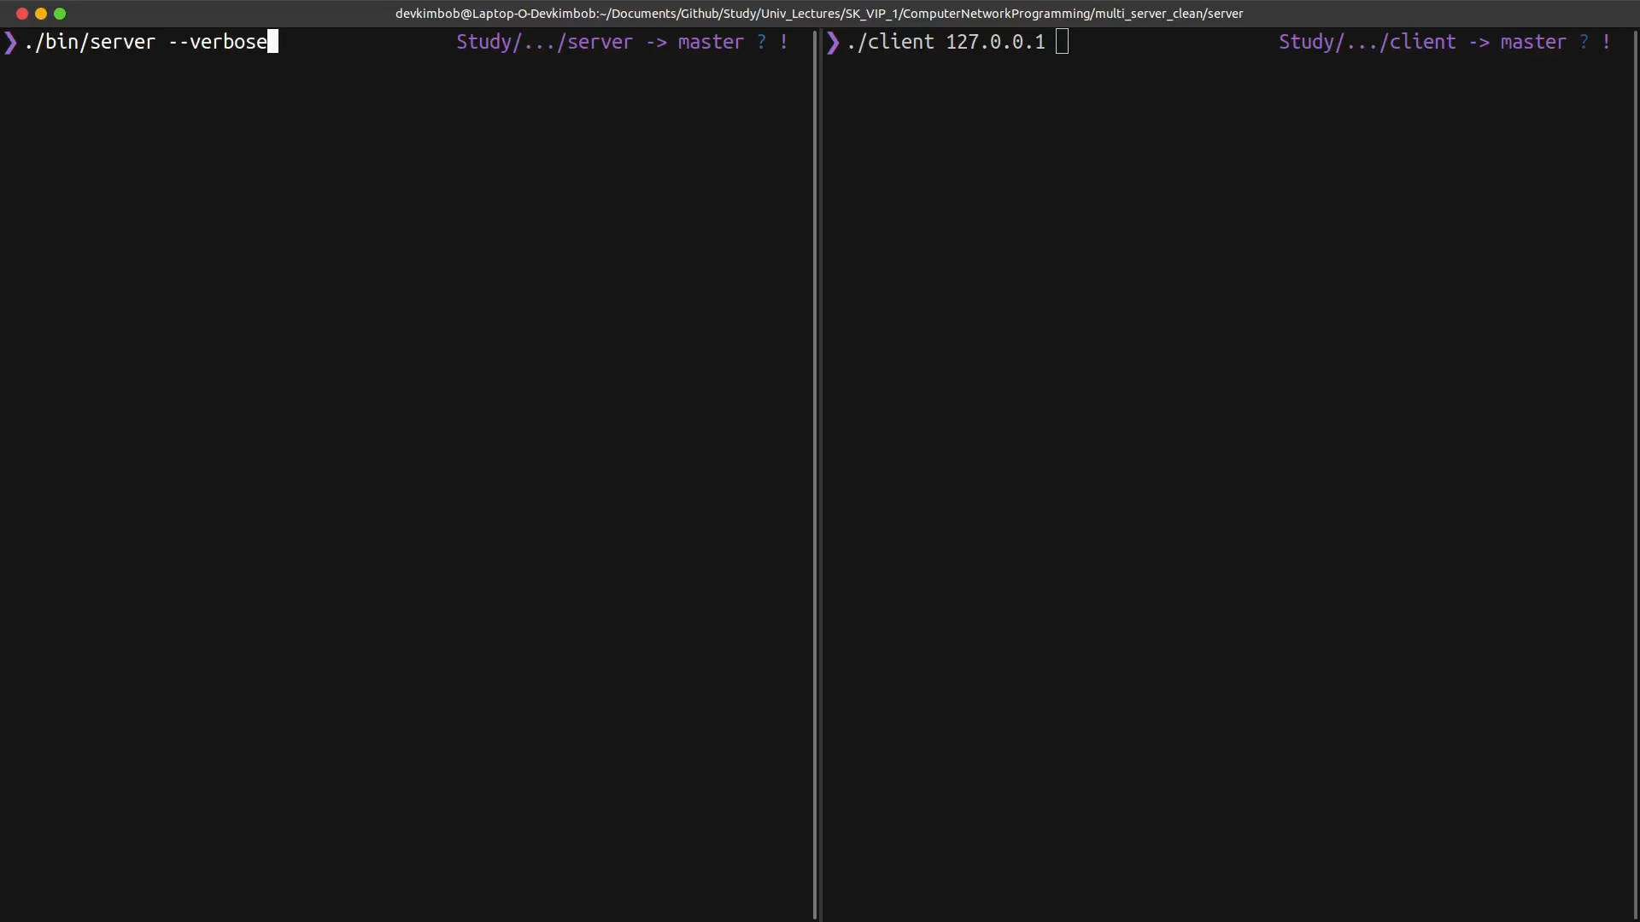
실행 영상 – verbose option

